Slide 1
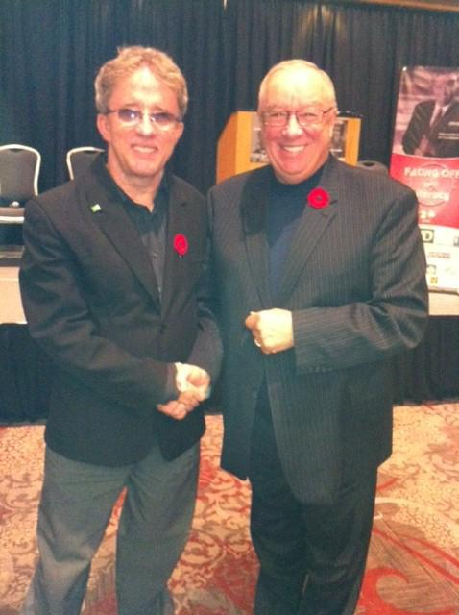
Learning Illiterate professional

Slide 2

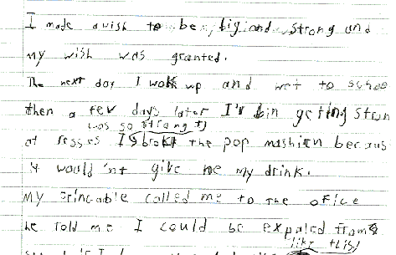


Slide 3
Pity Party
The parties went on and on!

Slide 4
TD Canada Trust
1. What Do You Do?
2. What’s Great About Your Work?
3. What Path Did You Take To Get There?
4. What Advice Would You Give To Others?

Slide 5
Telephone Banking Specialist TD Canada Trust
1:1 support
Simple changes to environment
White board
Skills and development coach
Support group
RESULT
meet/exceed quotas
able to provide excellent CEI

Slide 6

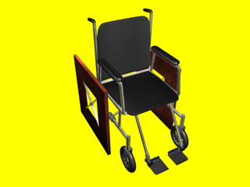
Dedicated to Jessica Colson!
She gave me the validation and
encouragement to change
chairs.

Slide 7

Lets lose the shame!
How do we make the invisible disabilities ,
And Abilities Visible??
John Dyson
hawk7164@hotmail.com

